Slide 1

Introduction to Artificial Intelligence
Face Recognition and Face Tracking Basics
Arinze Akutekwe, PhD

Slide 2
Learning Objectives
To understand data at a high level how AI and deep learning can be used to recognised objects like faces
How these can be applied to a camera to track a moving face in real-time
Perform step-by-step face detection process

Slide 3
Deep Learning using OpenCV
OpenCV is the open-source computer vision and machine learning library available mainly in C++, Java, MATLAB and Python.
It has over 2500 optimised algorithms and leans towards real-time vision applications.
OpenCV is the open-source computer vision and machine learning library available mainly in C++, Java, MATLAB and Python.
It has over 2500 optimised algorithms and leans towards real-time vision applications.
Notes:
- Data visualization is one of the primary skills
of any data scientist,
hence value cannot be understated.

Slide 4
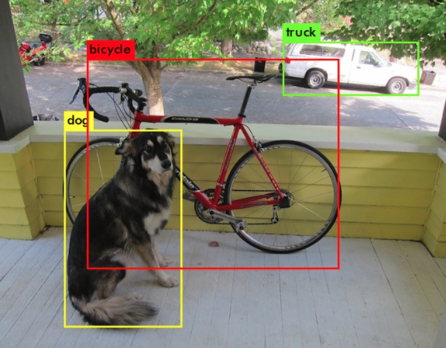
Object Detection
Object detection is the task of assigning a label to and a bounding box to some (or all) of the objects in an image.
Image credit:YOLO: https://pjreddie.com/darknet/yolo/

Slide 5
Classification vs Detection
Detection involves finding the position (e.g., an enclosing box) of an object category.

Slide 6
Detection basics
Intersection over Union is a basic evaluation metric used to measure the accuracy of an object detector on a dataset
IoU(P,G) >= 0.5: P is a True Positive
IoU(P,G) < 0.5: P is a False Positive
Image credit: pyimagesearch

Slide 7
Components of Object Detection
Sliding Window
Selective Search (Image Pyramids)
Non-maxima suppression

Slide 8
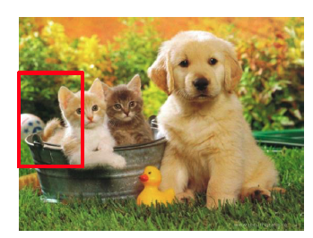
Sliding Window
Classes = [cat, dog, duck]
Cat ? NO
Dog ? NO
Duck? NO

Slide 9
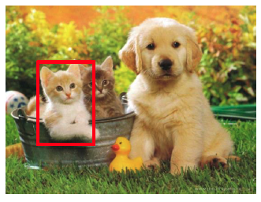
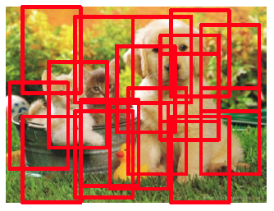
Sliding Window
Classes = [cat, dog, duck]
Cat ? Yes
Dog ? NO
Duck? NO
Image credit: Amaia Salvador

Slide 10
Selective search (Image Pyramids)
Selective search sequentially reduces (or in some cases, increases) the size of our input image.
It is called an image pyramid because stacking the images from largest to smallest looks like a pyramid.
The sliding window runs on each scale of the image pyramid, which enables detection of objects that are both closer and farther away from a camera.
Image credit: IIPImage

Slide 11
Non-maxima Suppression
Non-maxima suppression is used to keep only the most confident prediction when multiple detections surrounding the same object happens.
Image credit: pyimagesearch

Slide 12
Improved Methods
Training a neural network this way has many downsides
Sliding windows with selective search are incredibly slow, even when using a GPU
Tuning the scale for the selective search and step size for sliding window can be tedious.
For Day 2 we will discuss in more detail
Region Proposal Methods
R-CNN
Fast R-CNN
Faster R-CNN
Yolo (You only look once)
Single-shot detectors

Slide 13
SSD Summary
The face detector API is based on the Single Shot Detector (SSD) framework.
The SSD framework was first introduced by Liu et al. in their 2015 paper, ‘SSD: Single Shot MultiBox Detector’
Bounding box regression algorithms published by Szegedy et al. 2015 is used for the Mulitbox component
Single Shot implies that both localization and detection are performed in a single forward pass of the network during inference time. The network only has to “look” at the image once to obtain final predictions.

Slide 14
How face recognition works
Image credit: OpenFace by B. Amos et al 2016

Slide 15


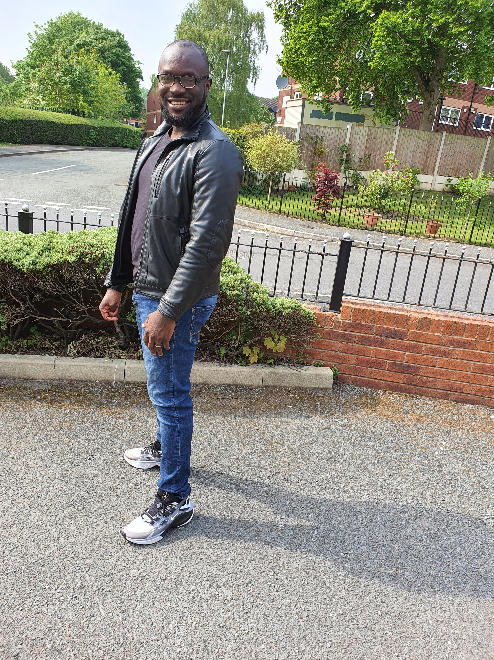



Results
After setting up the deep learning environment in Linux, I gathered a few images of myself and my wife for training.

Slide 16
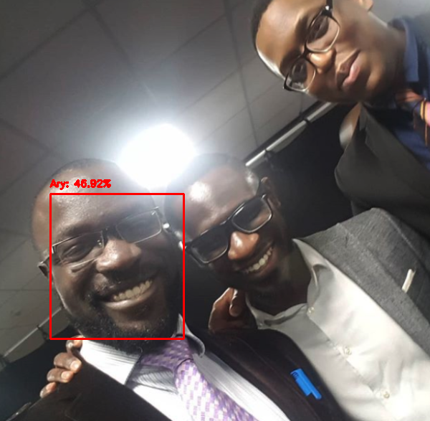
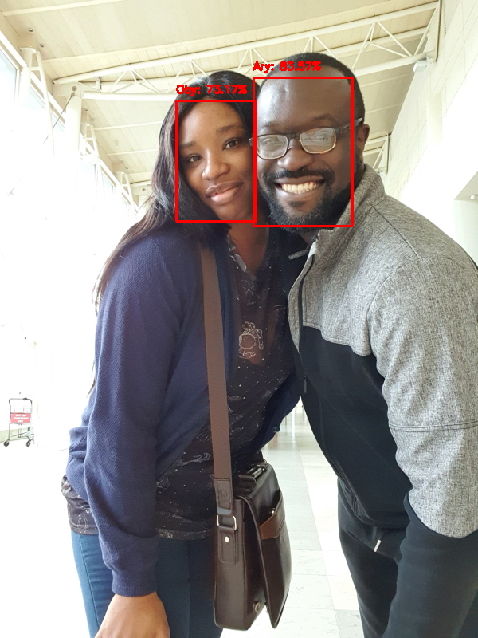
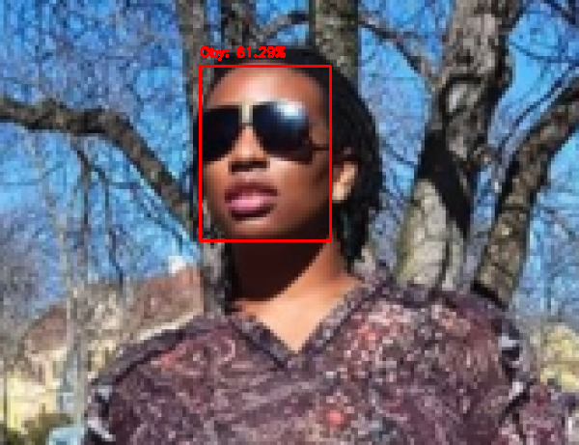
Results

Slide 17
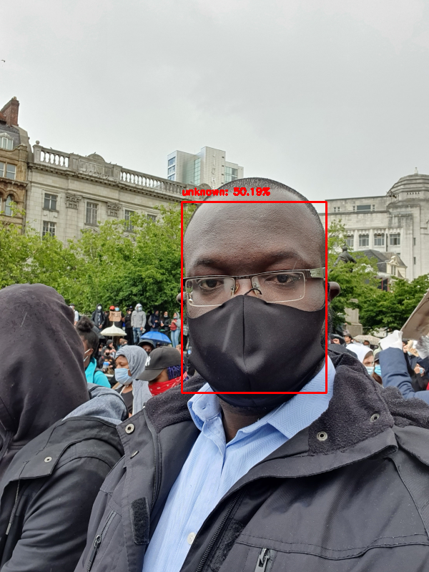
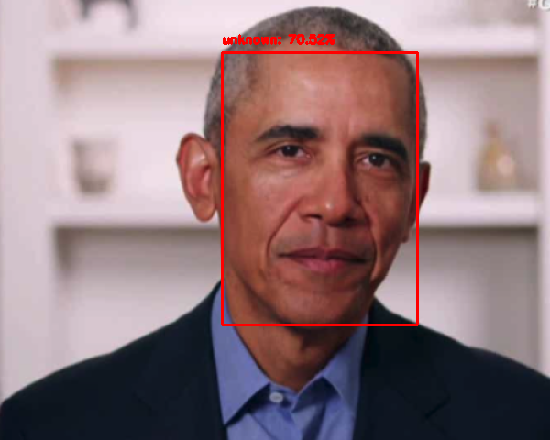
Results - Unknowns

Slide 18
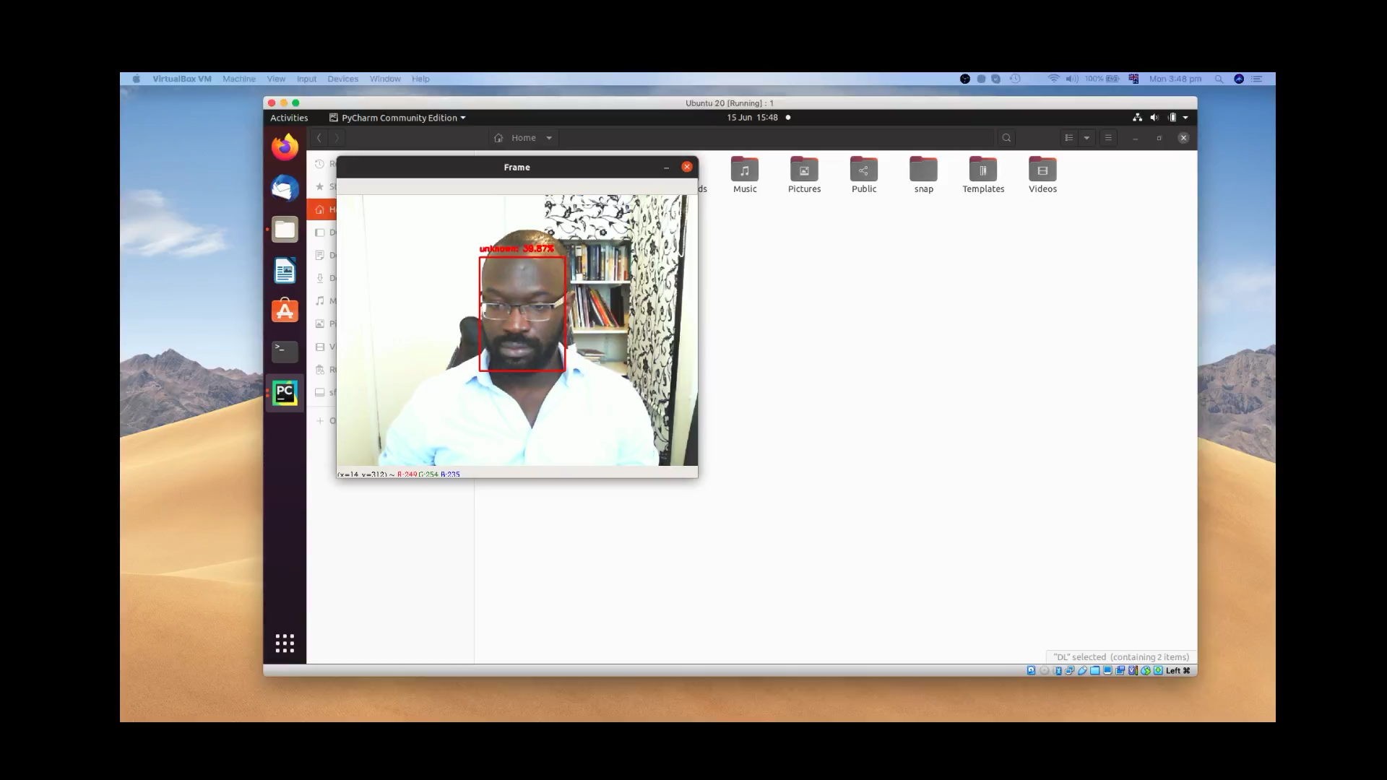
Using a Webcam

Slide 19
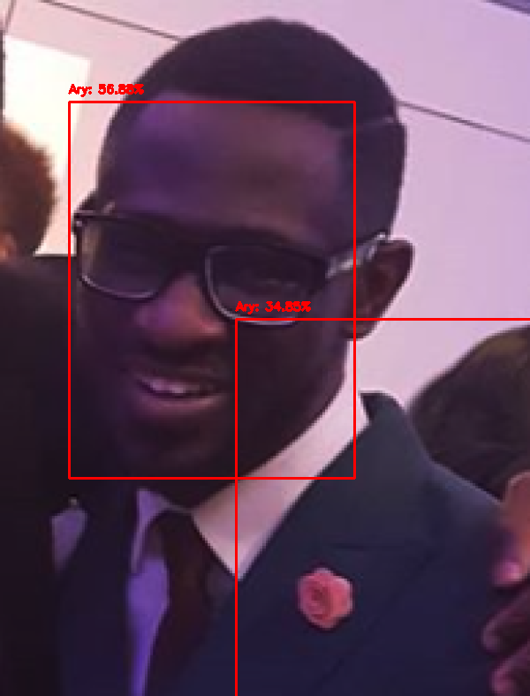
Misclassifications

Slide 20

Questions

